Slide 1
Comparative Investigation of the High Pressure Autoignition of the Butanol Isomers
B.W. Weber and C.J. Sung
Prepared for
Fall Technical Meeting of the
Eastern States Section of the Combustion Institute
October 10, 2011
Presenting: Bryan Weber

Slide 2
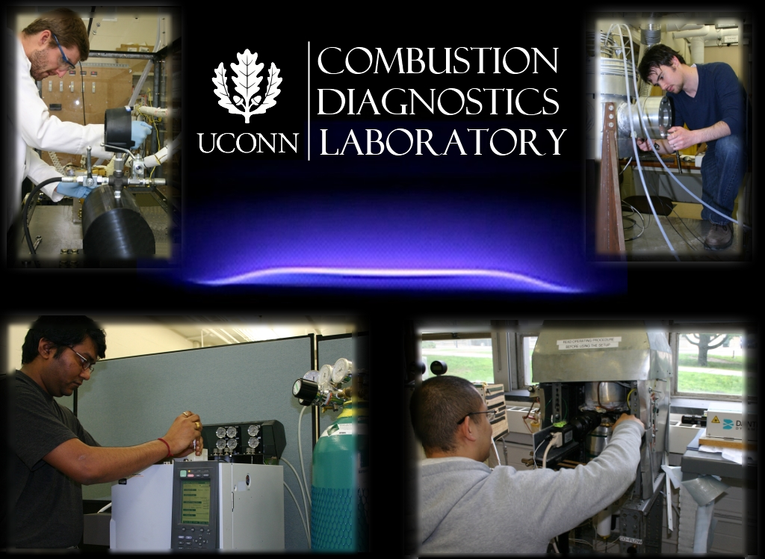
A Short PR Digression

Slide 3
Introduction
Butanols – 4 carbon alcohol with 4 isomers
Motivation – Why Butanol?
n-Butanol is a second generation biofuel with the potential to replace ethanol and gasoline
The isomers of butanol have potential as high-octane gasoline additives
The butanol system is the smallest alcohol system with primary, secondary and tertiary alcohol groups

Slide 4
Objectives
Investigate the butanol isomers to help determine their suitability for replacing traditional fuels in transportation applications
Low-temperature ignition delays provide a key measure of performance related to compression or spark ignition engines
Provide ignition delay data for all four butanol isomers at engine relevant conditions
Evaluate the ability of chemical kinetic models to predict the ignition delays

Slide 5
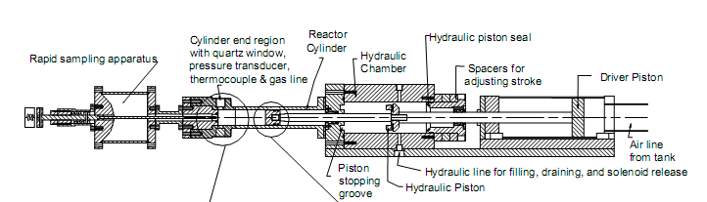
Rapid Compression Machine (1)
Single, retractable piston
Piston is pneumatically driven and hydraulically stopped, with compression time around 30 ms
Piston is machined with crevices to contain roll-up vortex created by piston motion

Slide 6
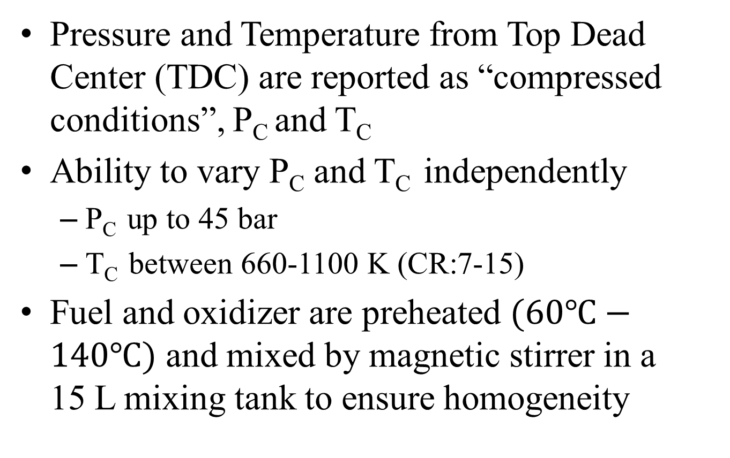
Rapid Compression Machine (2)
Pressure and Temperature from Top Dead Center (TDC) are reported as “compressed conditions”, P_{C} and T_{C}
Ability to vary P_{C} and T_{C} independently
P_{C} up to 45 bar
T_{C} between 660-1100 K (CR:7-15)
Fuel and oxidizer are preheated $(60℃−140℃)$ and mixed by magnetic stirrer in a 15 L mixing tank to ensure homogeneity

Slide 7
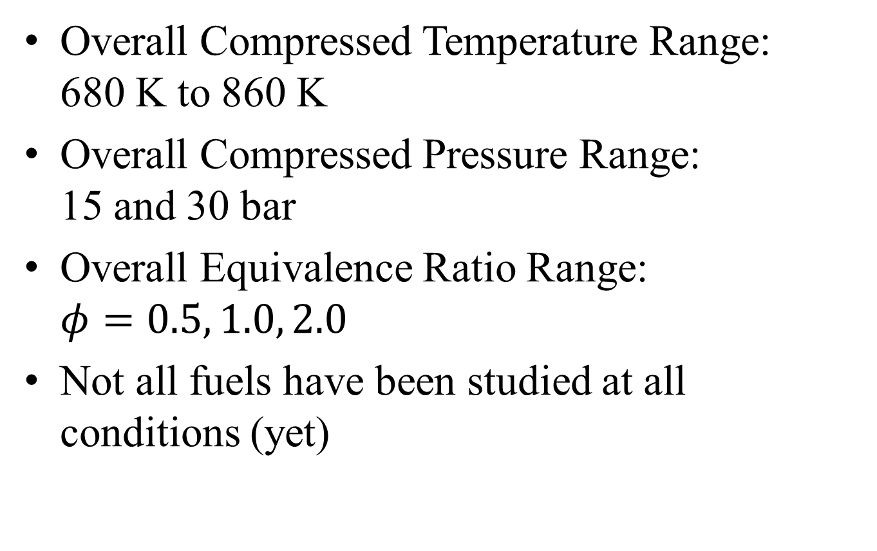
Experimental Conditions
Overall Compressed Temperature Range: 680 K to 860 K
Overall Compressed Pressure Range: 15 and 30 bar
Overall Equivalence Ratio Range: $φ=0.5, 1.0, 2.0$
Not all fuels have been studied at all conditions (yet)

Slide 8
Definition of Ignition Delay
Ignition criteria is the maximum rate of pressure rise
Ignition delay is the time difference from the end of compression to ignition point
Each condition is repeated at least 5 times to ensure repeatability
Non-reactive case replaces O₂ with inert to quantify effect of heat loss to the reactor walls

Slide 9
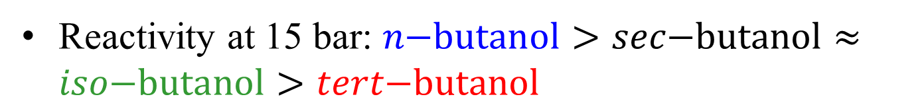
Experimental Results (1)
Reactivity at 15 bar: $n\text{−}\text{butanol}>sec\text{−}\text{butanol}≈iso\text{−}\text{butanol}>tert\text{−}\text{butanol}$

Slide 10
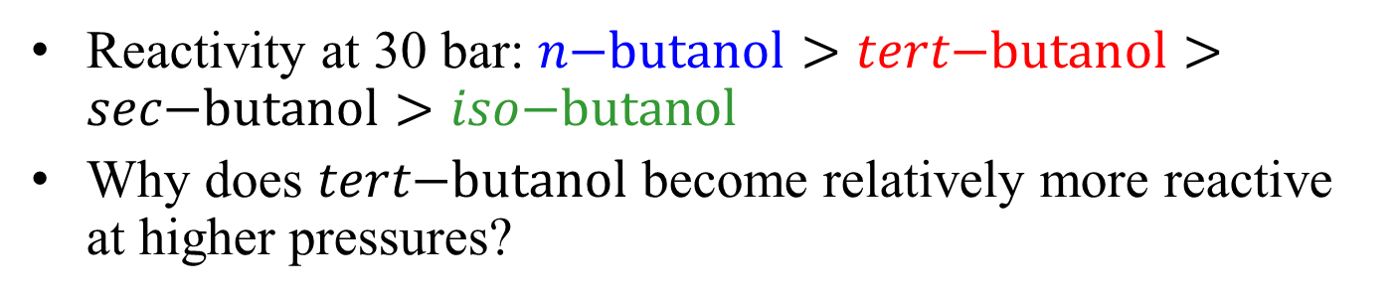
Experimental Results (2)
Reactivity at 30 bar: $n\text{−}\text{butanol}>tert\text{−}\text{butanol}>sec\text{−}\text{butanol}>iso\text{−}\text{butanol}$
Why does $tert\text{−}\text{butanol}$ become relatively more reactive at higher pressures?

Slide 11
Experimental Results (3)
Pressure traces from the RCM show clearly that there is pre-ignition heat release

Slide 12
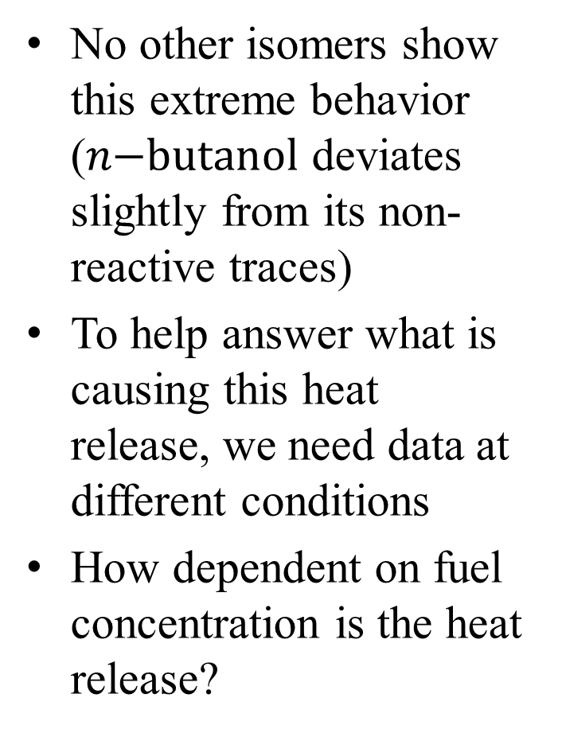
Experimental Results (4)
No other isomers show this extreme behavior ($n\text{−}\text{butanol}$ deviates slightly from its non-reactive traces)
To help answer what is causing this heat release, we need data at different conditions
How dependent on fuel concentration is the heat release?

Slide 13
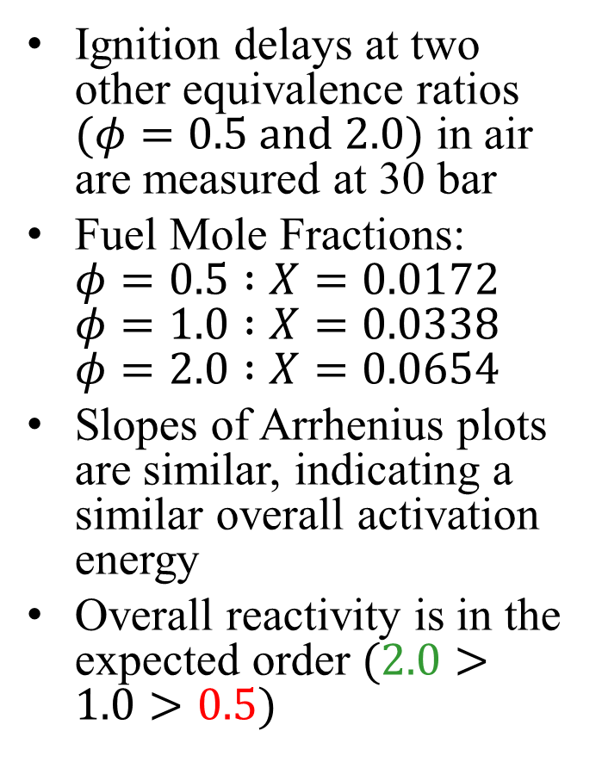
Experimental Results (5)
Ignition delays at two other equivalence ratios $(φ=0.5 \text{and} 2.0)$ in air are measured at 30 bar
Fuel Mole Fractions: $φ=0.5 :X=0.0172$ $φ=1.0 :X=0.0338$ $φ=2.0 :X=0.0654$
Slopes of Arrhenius plots are similar, indicating a similar overall activation energy
Overall reactivity is in the expected order $(2.0>1.0>0.5)$

Slide 14
Experimental Results (6)
At lower and higher fuel concentrations, pre-ignition heat release is still evident
Results for different equivalence ratios are qualitatively different

Slide 15
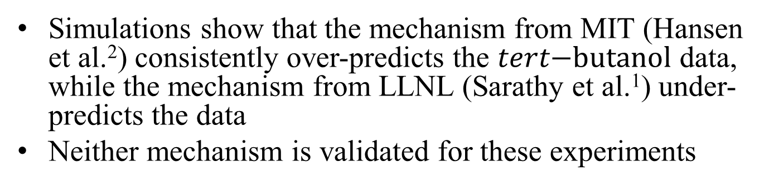
Comparison with Simulations (1)
Simulations show that the mechanism from MIT (Hansen et al.²) consistently over-predicts the $tert\text{−}\text{butanol}$ data, while the mechanism from LLNL (Sarathy et al.¹) under-predicts the data
Neither mechanism is validated for these experiments
1. Sarathy, S.M., Vranckx, S., Yasunaga, K., Mehl, M., Oßwald, P., Westbrook, C. K., Pitz, W.J., Kohse-Hoinghaus, K., Fernandes, R.X., and Curran, H.J. Submitted to Combustion and Flame, Sept. 2011
2. Hansen, N., Harper, M.R., and Green, W.H. Submitted to Physical Chemistry Chemical Physics, Aug. 2011

Slide 16
Comparison with Simulations (2)
Despite reasonable agreement in overall ignition delay, the pressure traces are not well reproduced by the mechanism from LLNL

Slide 17
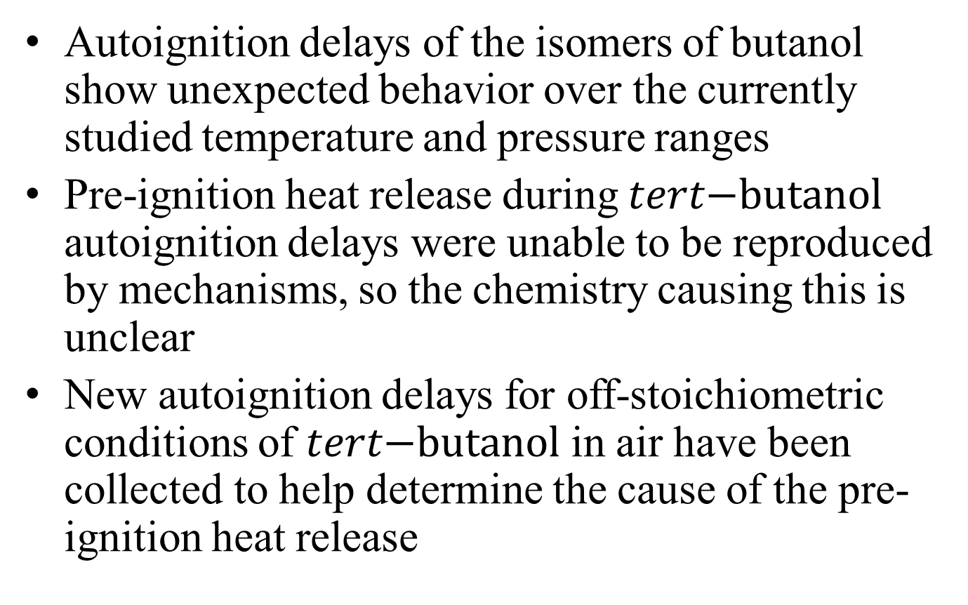
Summary (1)
Autoignition delays of the isomers of butanol show unexpected behavior over the currently studied temperature and pressure ranges
Pre-ignition heat release during $tert\text{−}\text{butanol}$ autoignition delays were unable to be reproduced by mechanisms, so the chemistry causing this is unclear
New autoignition delays for off-stoichiometric conditions of $tert\text{−}\text{butanol}$ in air have been collected to help determine the cause of the pre-ignition heat release

Slide 18
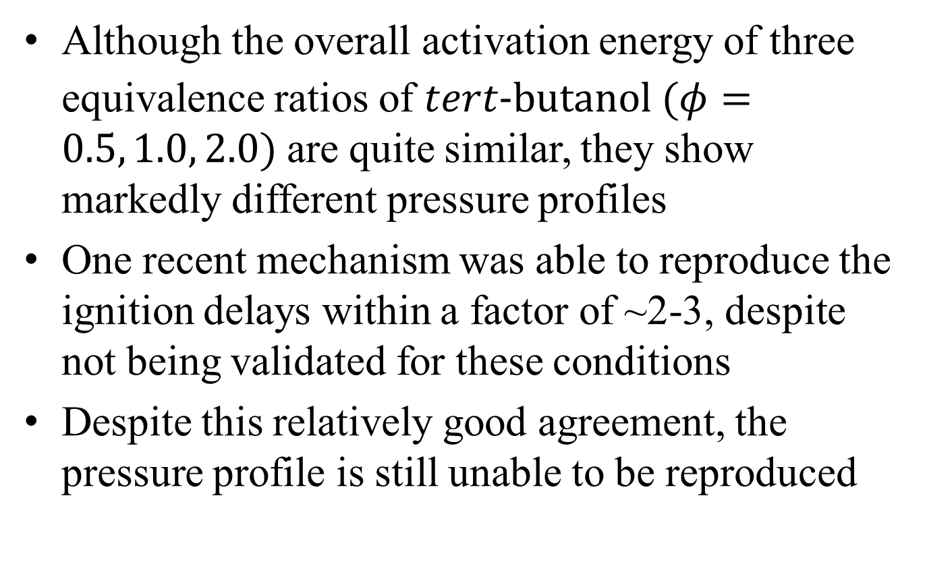
Summary (2)
Although the overall activation energy of three equivalence ratios of $tert\text{−}\text{butanol}$ $(φ=0.5, 1.0, 2.0)$ are quite similar, they show markedly different pressure profiles
One recent mechanism was able to reproduce the ignition delays within a factor of ~2-3, despite not being validated for these conditions
Despite this relatively good agreement, the pressure profile is still unable to be reproduced

Slide 19
Acknowledgements
This material is based upon work supported as part of the Combustion Energy Frontier Research Center, an Energy Frontier Research Center funded by the U.S. Department of Energy, Office of Science, Office of Basic Energy Sciences, under Award Number DE-SC0001198
Dr. Mani Sarathy for providing his mechanism prior to publication, and for helpful discussions
Dr. Bill Green for providing his mechanism prior to publication, and for helpful discussions

Slide 20
Thank you!
Bryan Weber
bryan.weber@uconn.edu

Slide 21
Comparison with Simulations
Constant Volume, Adiabatic Simulations
Mechanisms are NOT validated for 30 bar cases
Agreement for 15 bar cases is reasonable – agreement for 30 bar cases is luck of the draw
1. Sarathy, S.M., Vranckx, S., Yasunaga, K., Mehl, M., Oßwald, P., Westbrook, C. K., Pitz, W.J., Kohse-Hoinghaus, K., Fernandes, R.X., and Curran, H.J. Submitted to Combustion and Flame, Sept. 2011
2. Hansen, N., Harper, M.R., and Green, W.H. Submitted to Physical Chemistry Chemical Physics, Aug. 2011
3. Weber, B.W., and Sung, C.J. National Combustion Meeting.

